Slide 1
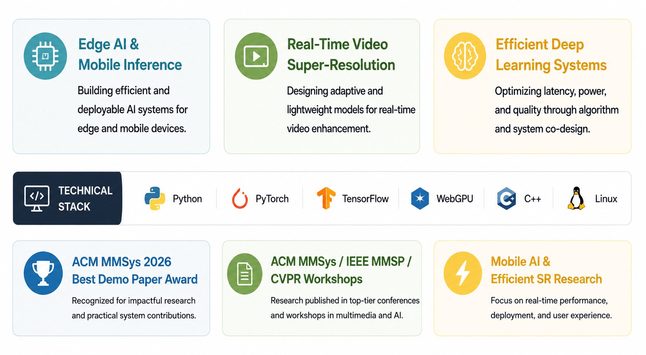
Matin Fazel M.Sc. Computer Science — Concordia University Researcher in efficient AI systems for real-time multimedia, browser, and mobile deployment.

Slide 2
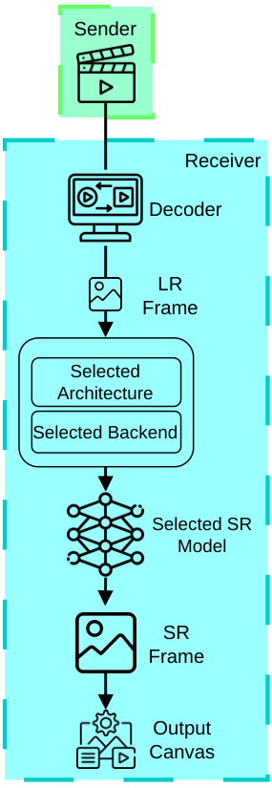
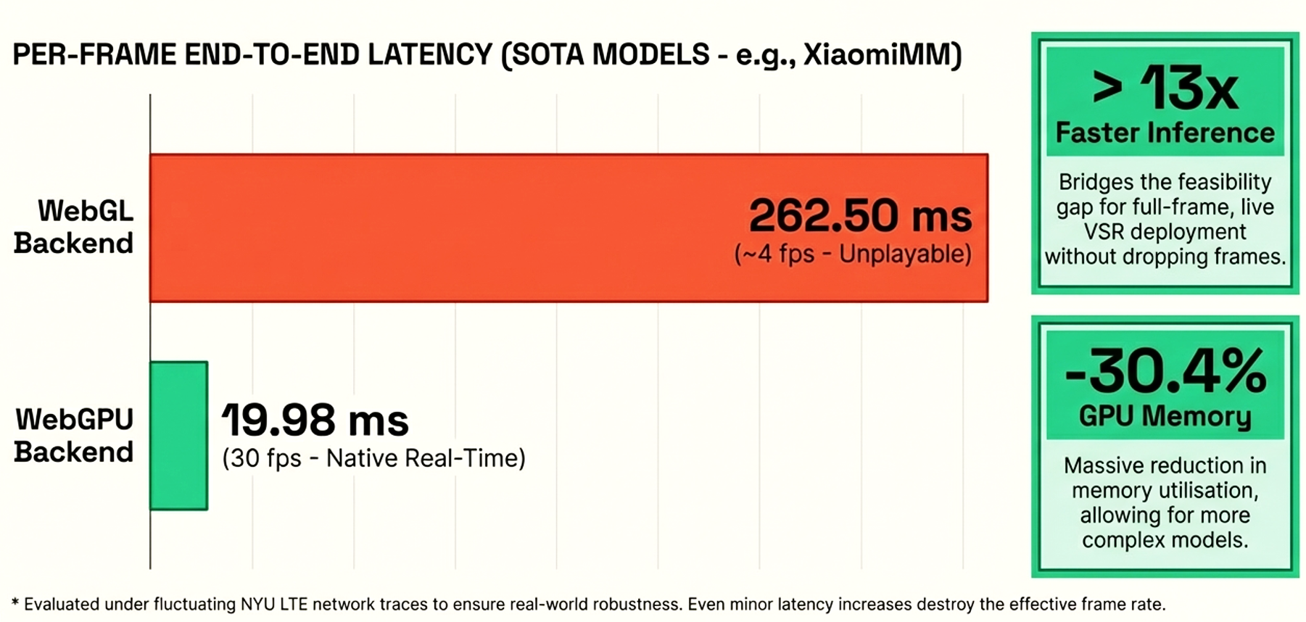


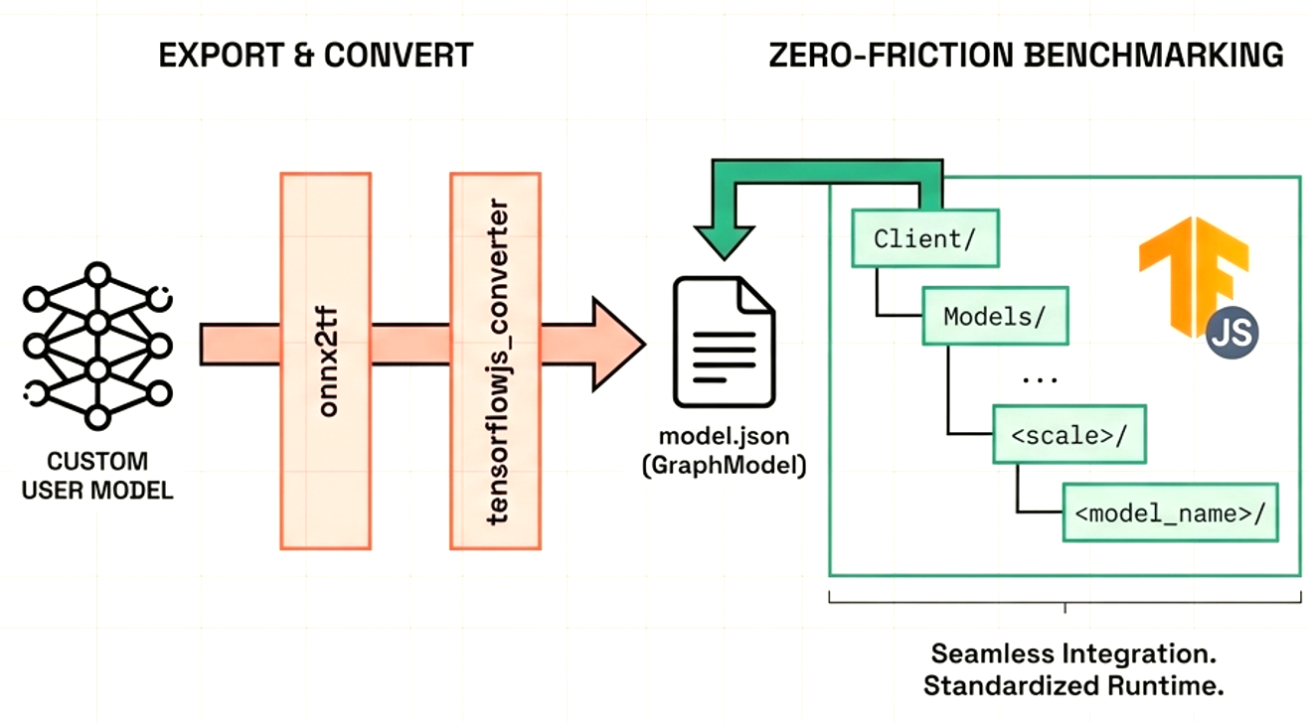




VSR-Bench: Browser-Native Real-Time Video Super-Resolution
Platform Overview
Architecture
The WebGPU Advantage
The Problem
Strict Latency constraint in RTC
Lack Of SR-Bench in RTC
Deep VSR is too heavy for RTC
Latency + Quality trade-offs
The Solution
VSR-Bench is the first browser-native benchmark for efficient SR over WebRTC pipelines.
The Capabilities
Evaluates SISR models (plug-and-play) across quality–latency trade-offs.
ACM MMSys 2026, Hong Kong, Hong Kong

Slide 3
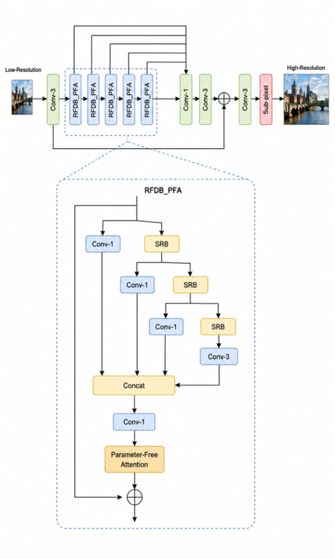
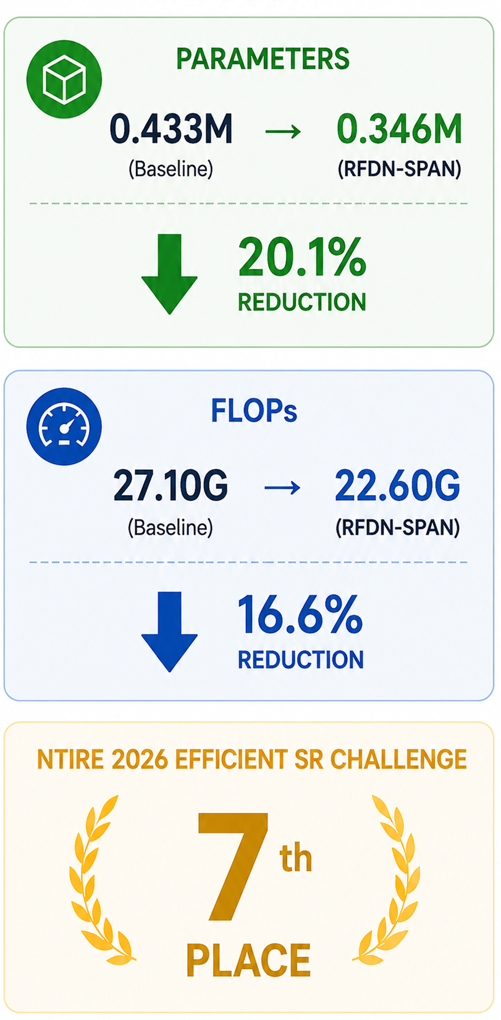
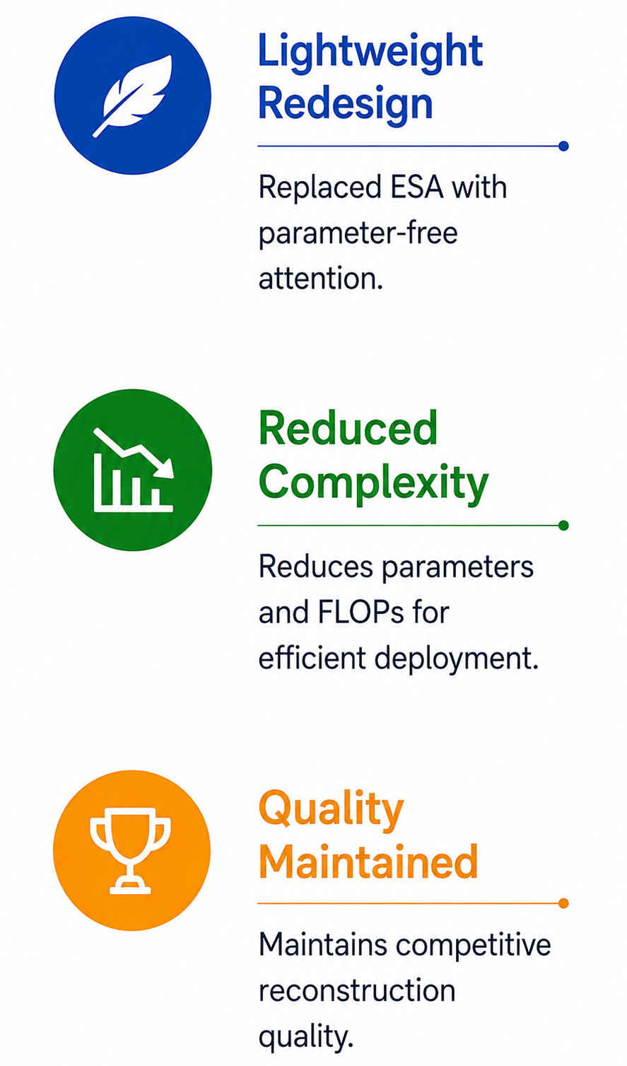

RFDN-SPAN: Lightweight Parameter-Free Attention for Efficient Super-Resolution
Contributions
Architecture
Results
NTIRE 2026 Efficient Super-Resolution Challenge at CVPR 2026 NTIRE Workshop

Slide 4
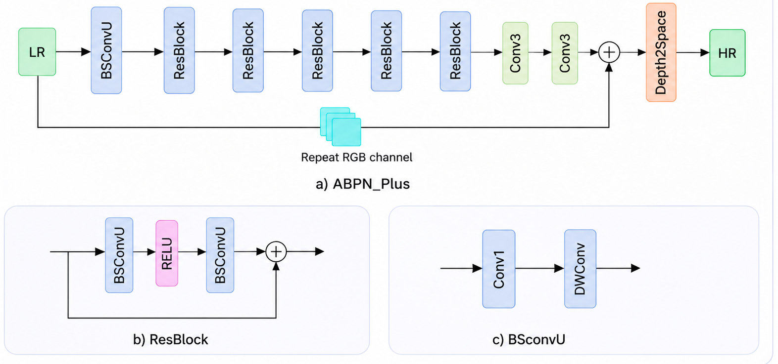
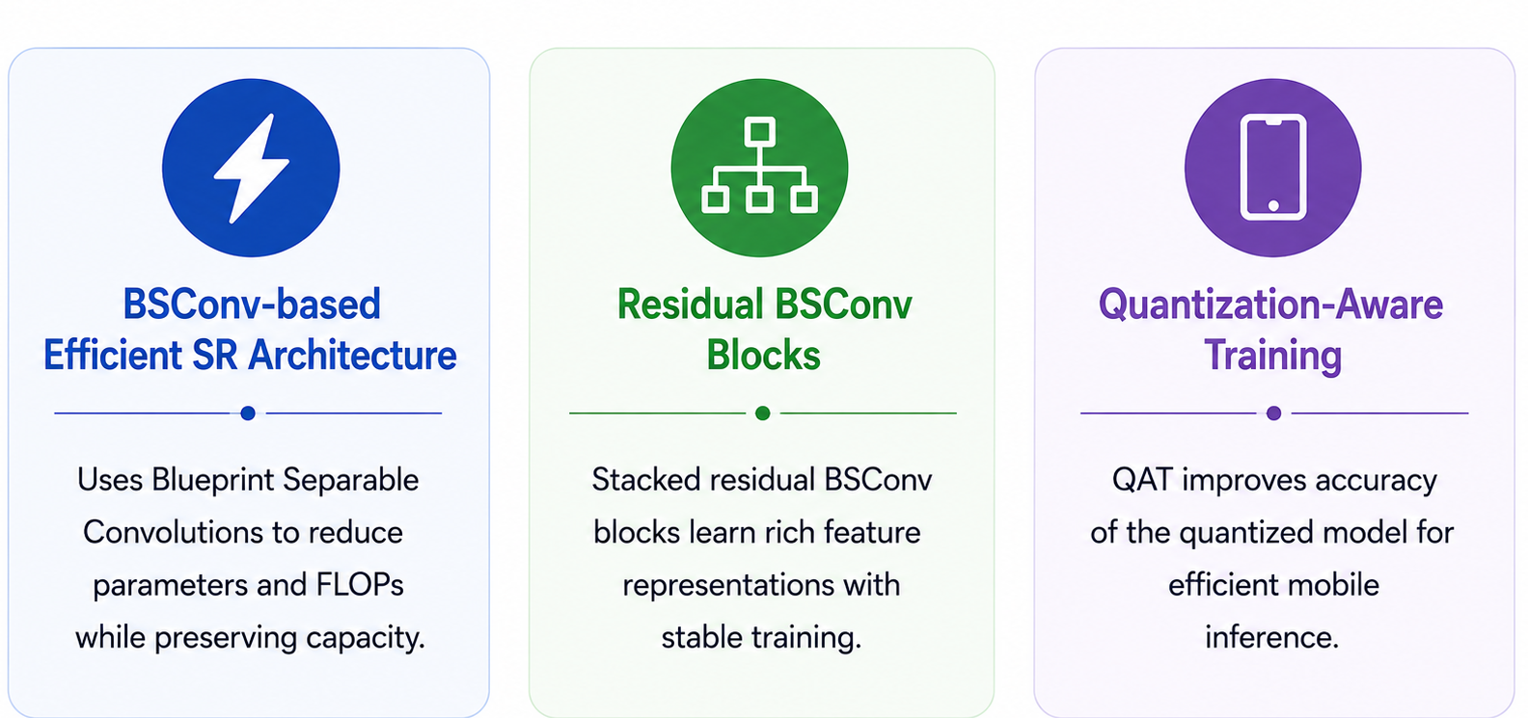
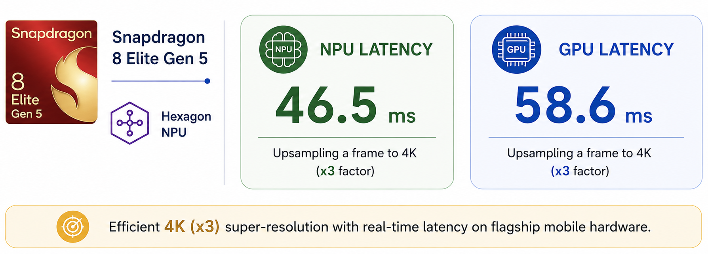
APBN Plus: Lightweight BSConv-based SR architecture for mobile developments
Architecture
Contributions
4K Quantized Image Super-Resolution 2026 Challenge at CVPR 2026 Workshop

